Slide 1
Energy Consumption Forecast
Presented By,
Harshitha Josyula
Shaheen Chirakula
Vishu Vikas Nallamalli
Meghana Kesana
Mera Mathew

Slide 2
OBJECTIVES
Identify Drivers of Electricity Consumption
Develop a Predictive Model
Deliver Actionable Insights
Interactive User Interface
Explore how changes in total electricity load influence electricity price.
Assess the role of renewable generation in shaping pricing dynamics.
Use regression analysis to forecast electricity price based on:
Total electricity load
Renewable generation
Additional attributes (e.g., weather, time, and system conditions).
Highlight correlations and trends between load, renewable generation, and pricing.
Support energy stakeholders in making data-driven decisions.
Provide an accessible platform for users to explore personalized recommendations and optimize energy consumption.

Slide 3
DATA DESCRIPTION
Total Load Actual
The actual total electricity demand (in megawatts, MW) recorded at specific timestamps.
05
Weather-Related Features
Meteorological data, including temperature, wind speed, and other parameters that impact energy production and consumption.
01
04
Time-Related Features
Timestamps or date-related columns used to capture temporal patterns in energy demand and pricing.
Price Actual
The actual electricity price (in €/MWh) corresponding to each timestamp, serving as the target variable for prediction.
02
03
Renewable Generation
Total electricity generated from renewable sources (in MW), a critical feature influencing pricing.

Slide 4
EXPLORATORY DATA ANALYSIS

Slide 5
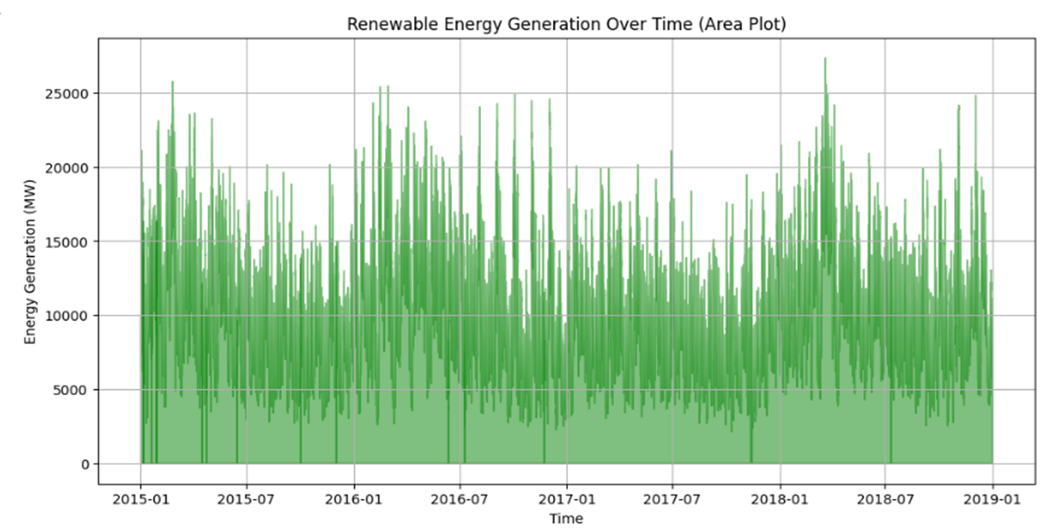
Renewable Energy Generation Over Time
Insights:
- Renewable energy fluctuates heavily.
- Seasonal peaks are visible, driven by wind and solar energy.
- Increasing trend indicates growth in renewables.

Slide 6
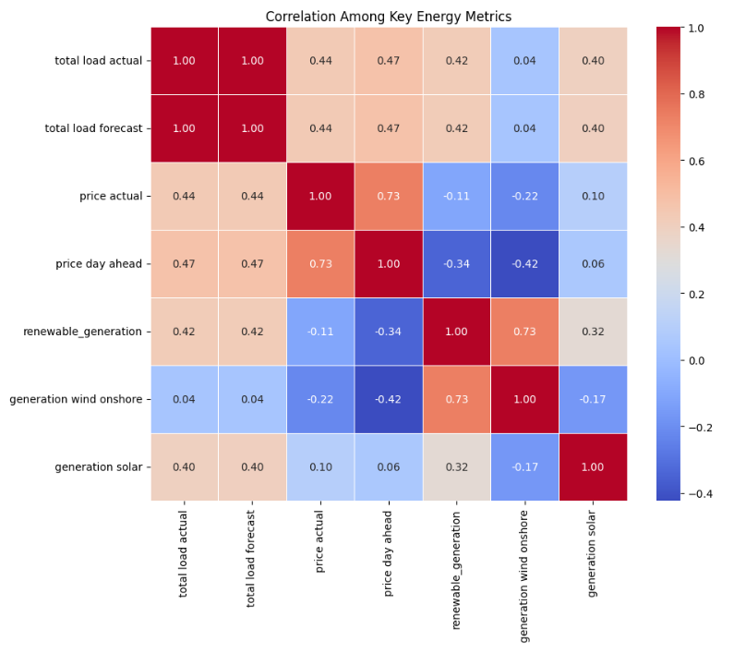
Exploratory Data Analysis Insights
Correlation Heatmap: Energy Metrics
Insights:
- 'Total load actual' strongly correlates with 'total load forecast'.
- Renewable generation impacts energy prices moderately.
- Wind generation is a major driver of renewables.

Slide 7
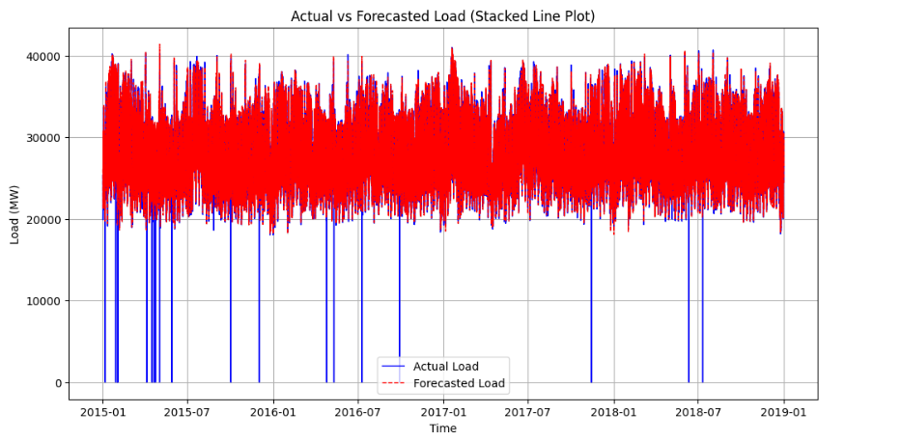
Actual vs Forecasted Load
Insights:
The forecasted load closely matches the actual load, indicating high prediction accuracy.
Sharp drops in the actual load suggest data anomalies or recording issues.
Load patterns remain stable over time, with fluctuations likely driven by seasonal trends.

Slide 8
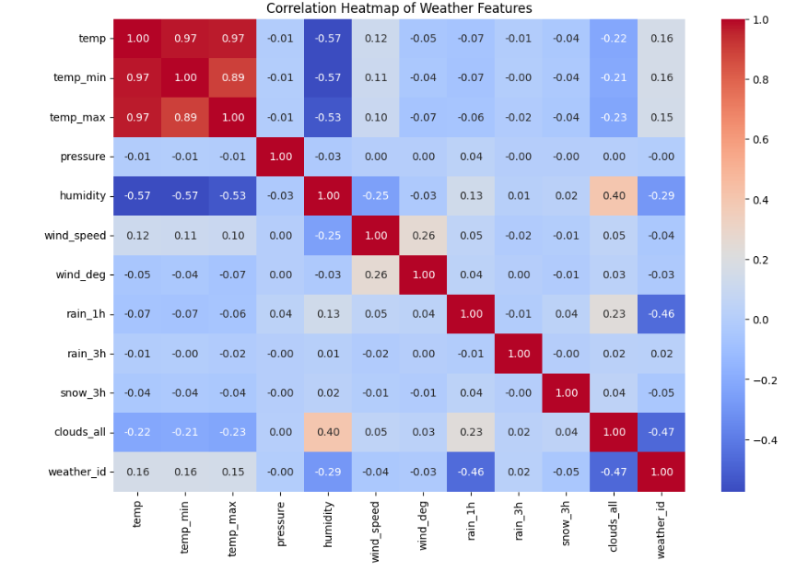
Exploratory Data Analysis Insights
Correlation Heatmap: Weather Features
Insights:
- Strong correlation between temperature metrics.
- Humidity negatively correlates with temperature.
- Cloud cover moderately influences humidity.

Slide 9
Model Selection
1.Gradient Boosting Regressor :
Reason - Energy consumption is inherently complex, influenced by multifaceted variables such as temperature, time of day, seasonal variations, and socio-economic factors. The Gradient Boosting Regressor excels in this challenging environment by Capturing non-linear relationships,Handling diverse data types,Providing robust feature importance analysis.
2.Random Forest Regressor :
Reason- The algorithm's strength lies in its ability to simultaneously address multiple challenges inherent in energy forecasting. It seamlessly integrates diverse data types, manages intricate non-linear relationships
Student Name
Class Name

Slide 10
Model Selection
3.XG Boost :
Reason- The algorithm's core strength lies in its ability to handle complex, non-linear relationships while maintaining exceptional predictive accuracy.
4.Cat Boost Regressor :
Reason -It helps to bridge the gap between raw data and actionable energy insights, offering unprecedented precision in consumption forecasting.
5.Support Vector Regressor :
Reason- SVR provides a unique approach to predictive modeling. It focuses on finding a regression line that deviates minimally from actual data points, creating a more nuanced predictive framework compared to traditional methods.
Student Name
Class Name

Slide 11
RMSE | Gradient Boosting Regressor | Random Forest Regressor | XG Boost | Cat Boost Regressor | Support Vector Regressor
RMSE Before Fine Tuning | 0.3786 | 0.5305 | 0.46 | 0.4094 | 0.39
RMSE After Fine Tuning | 0.3339 | 0.53 | 0.56 | 0.3968 | 0.36

Slide 12
Gradient Boosting Classifier
Strengths
Handles Complex Non-Linear Relationships
Energy consumption data includes complex interactions between features (e.g., weather conditions, energy generation types, temperature).
Feature Importance
Gradient Boosting provides insights into which features contribute most to predictions - weather conditions, temperature, and energy generation sources are ranked based on their importance.
The model provided a lower RMSE (Root Mean Squared Error) of 0.33385551646016526
By controlling parameters like tree depth and learning rate, Gradient Boosting reduces the risk of overfitting the training data.

Slide 13
Model Performance - Gradient Boosting Classifier
Baseline Parameters:
n_estimators=100
learning_rate=0.1
max_depth=3
Best Parameters Found:
n_estimators: 200
max_depth: 4
learning_rate: 0.2
Performance Before Fine-Tuning:
Train RMSE: 0.2304
Test RMSE: 0.3786
Train R²: 94.7%
Test R²: 85.1%
Performance After Fine-Tuning:
Test RMSE: 0.3339
Hyperparameter Tuning:
Grid Search (135 iterations):
Explored combinations of n_estimators, learning_rate, and max_depth.
Randomized Search:
Faster exploration over 10 iterations.
RMSE improved from 0.3786 →0.3339,

Slide 14
Future Work
3. Sustainability and Energy Efficiency
Support renewable energy optimization and demand response analysis.
Explore opportunities for energy waste reduction and conservation.
1. Model Enhancements
Use ensemble methods
Implement deep learning models
2.Feature Engineering
Add time-based features
Integrate external data sources

Slide 15
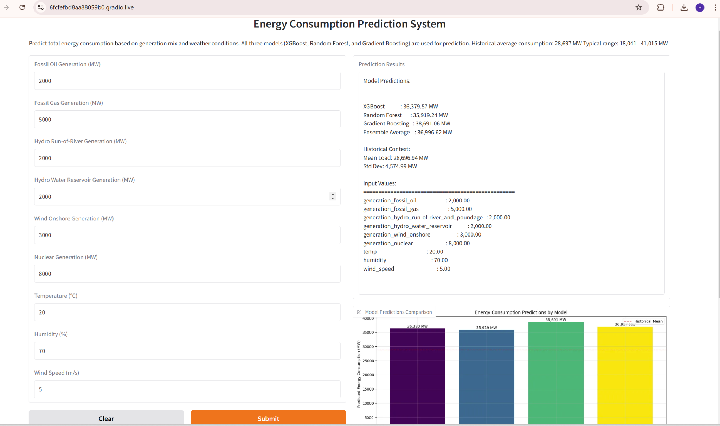
Deployment
https://2897f13e1bc4a9bee6.gradio.live

Slide 16
Thank You

